Slide 1
TUTORIAL 7
CREATING A COMPUTATIONAL STYLESHEET

Slide 2
OBJECTIVES
In this chapter you will:
Learn how to number nodes
Apply XPath functions such as count() and sum()
Create formulas using mathematical operators
Work with text nodes and white space
Create variables and parameters

Slide 3
OBJECTIVES
In this chapter you will:
Create named and recursive templates
Work with multiple style sheets
Learn how to use extension functions and elements

Slide 4
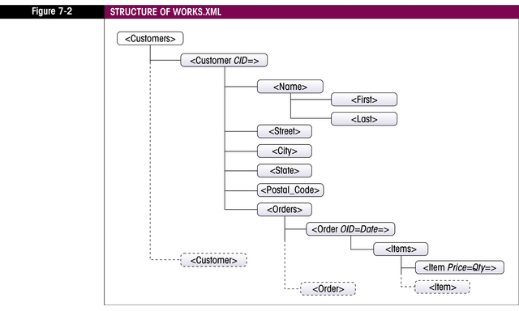
VIEWING THE ORDERS REPORT
Case project for tutorial displays customer orders
Structure of XML:

Slide 5
NUMBERING NODES
Number nodes using:
  <xsl:number>
  position()
Using position():
  Nodes are numbered by position in result document
  Can be used in conditional statements

Slide 6
USING <XSL:NUMBER>
Nodes are numbered according to position in source document
Attributes:
  value=expression: any XPath expression that evaluates to a number (i.e. position())
  count=pattern: specifies which nodes to count
  level=type: tree level for nodes to count; can be any, single, or multiple

Slide 7
USING <XSL:NUMBER>
Attributes:
  from=pattern: pattern indicates where numbering should restart
  format=pattern: pattern indicates number format
  grouping-size, grouping-separator: indicate how digits are grouped and separator character

Slide 8
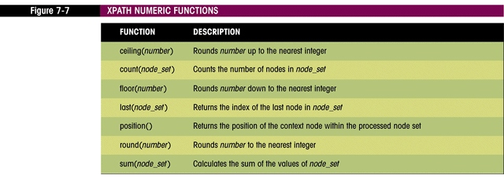
WORKING WITH XPATH FUNCTIONS
Used to calculate numerical values or manipulate text strings
Numerical functions:

Slide 9
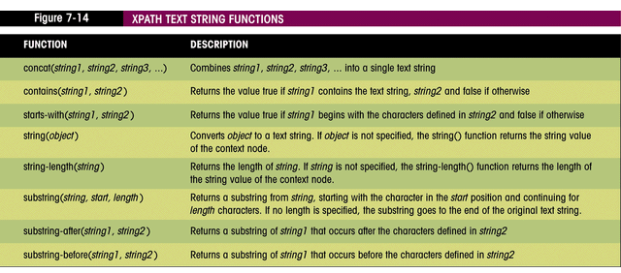
XPATH TEXT FUNCTIONS

Slide 10
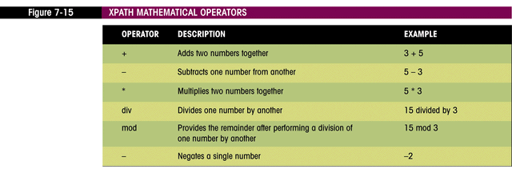
WORKING WITH MATHEMATICAL OPERATORS
Six operators:

Slide 11
FORMATTING NUMBERS
XPath function format-number
Syntax: format-number(value, format)
Example: format-number(56823.847, “#,##0.00”) displays 56,823.85

Slide 12
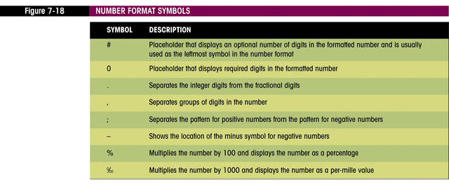
NUMBER FORMAT SYMBOLS

Slide 13
<XSL:DECIMAL-FORMAT>
Holds decimal formatting information
Controls separator characters such as . and ,
Can be named or default if un-named
Named decimal format passed as argument to format-number

Slide 14
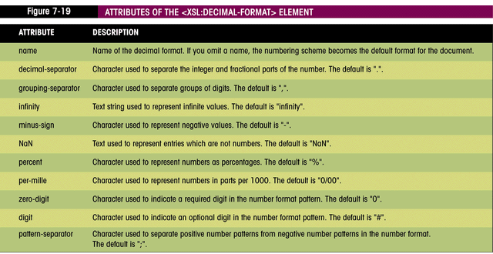
<XSL:DECIMAL-FORMAT> ATTRIUTES

Slide 15
INSERTING ATTRIBUTE VALUES
XSLT expression inserted into HTML attribute value
Syntax: <tag attribute=”{XSLT expression}” >
Example: <td rowspan=”{count(../../Items/Item)}”>

Slide 16
WORKING WITH TEXT NODES AND WHITE SPACE
White space:
  Space devoid of any printable character
  Space, tab, new line, carriage return
Adjacent <xsl:value-of> elements will have results combined to eliminate white space
<xsl:text> can be used to create white space:
  Syntax: <xsl:text>Text</xsl:text>
  Can only contain literal text

Slide 17
WHITE SPACE ENTITIES
Space - &#x20;
Tab - &#x9;
New line - &#xA;
Carriage return - &#xD;

Slide 18
CONTROLLING WHITESPACE
Stripping space:
  Remove text nodes from the result document that contain only white space
  Syntax: <xsl:strip-space elements=“pattern”>
  Use * as pattern to match all nodes

Slide 19
CONTROLLING WHITESPACE
Preserving space:
  Make sure that text nodes that contain only white space are not deleted
  Syntax: <xsl:preserve-space elements=“pattern”>
  Use * as pattern to match all nodes
Normalize space:
  Remove leading and trailing spaces
  Syntax: normalize-space(text)

Slide 20
USING VARIABLES
User-defined name that stores a particular value or object
Types:
  number
  text string
  node set
  boolean
  result tree fragment

Slide 21
USING VARIABLES
Syntax: <xsl:variable name=“name” select=“value”/>
Example: <xsl:variable name=”Months” select=”12” />
Names are case-sensitive
Value only set once upon declaration
Enclose text strings in single-quotes

Slide 22
USING VARIABLES
Value can be XPath expression
Boolean type:
  Set value to expression that is true or false
Result tree fragment type:
  Syntax:
  <xsl:variable name=”Logo”>
<img src=”logo.gif” width=”300” height=”100” />
</xsl:variable>

Slide 23
REFERENCING VARIABLES
Syntax: $variable-name
Example: $Months
Referencing tree fragments:
  Do not use $variable-name
  Use <xsl:copy> or <xsl:copy-of> to reference value

Slide 24
COPYING
<xsl:copy>
  Syntax: <xsl:copy use-attribute-sets=”list” />
  Shallow copy: only node itself is copied
<xsl:copy-of>
  Syntax: <xsl:copy-of select=“expression”/>
  Deep copy: node and descendants are copied

Slide 25
VARIABLE SCOPE
Global:
  Can be referenced from anywhere within the style sheet
  Must be declared at the top level of the style sheet, as a direct child of the <xsl:stylesheet> element
  Must have a unique variable name
Local:
  Referenced only within template
  Can share name with other local or global variable

Slide 26
USING PARAMETERS
Similar to variables, but:
  Value can be changed after it is declared
  Can be set outside of scope
Syntax: <xsl:param name=“name” select=“value”/>
Example: <xsl:param name=”Filter” select=”'C103'” />
To reference: $param-name

Slide 27
SETTING PARAMETER VALUES EXTERNALLY
Depends on XSLT processor
Some work by appending parameter value to url
Command line processors allow external parameter setting:
  MSXML
  Saxon

Slide 28
TEMPLATE PARAMETERS
Local in scope
Created inside <xsl:template> element
To pass parameter to template
  place <xsl:with-param> element in <xsl:apply-templates> element
  Syntax: <xsl:with-param name=“name” select=“value”/>
  No error if calling param name does not match template param name

Slide 29
INTRODUCING FUNCTIONAL PROGRAMMING
Functional programming language:
  Relies on the evaluation of functions and expressions, not sequential execution of commands
  Different from most other languages

Slide 30
FUNCTIONAL PROGRAMMING PRINCIPLES
Main program consists entirely of functions with well-defined inputs
Results of program are defined in terms of function outputs
No assignment statements; when a variable is declared, its value cannot be changed
Order of the execution is irrelevant

Slide 31
FUNCTIONAL PROGRAMMING
Easier to maintain and less susceptible to error
No order of execution
Each time a function is called, it does the same thing, regardless of how many times it has already been called, or the condition of other variables in the program
Important to think about the desired end result, rather than the sequential steps needed to achieve that effect

Slide 32
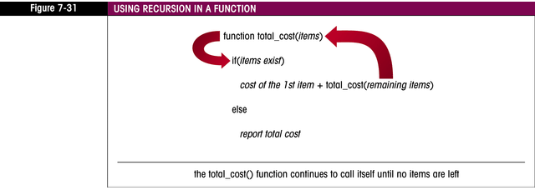
RECURSION
Takes the place of looping structures in functional programming
Function calls itself

Slide 33
USING NAMED TEMPLATES
Template not associated with node set
Collection of functions and commands that are accessed from other templates in the style sheet
Syntax:
<xsl:template name="name">
XSLT elements
</xsl:template>

Slide 34
CALLING NAMED TEMPLATES
Syntax:
<xsl:call-template name=”name”>
<xsl:with-param />
<xsl:with-param />
...
</xsl:call-template>

Slide 35
WRITING A RECURSIVE TEMPLATE
Templates that call themselves, usually passing along a new parameter value with each call
Needs to have a stopping condition
  Expressed in an if statement or a choose statement
  If missing, will call itself without end

Slide 36
WRITING A RECURSIVE TEMPLATE
Syntax with <xsl:if>:
  <xsl:template name=”template_name”>
  <xsl:param name=”param_name” select=”default_value” />
  ...
  <xsl:if test=”stopping_condition”>
  ...
  <xsl:call-template name=”template_name”>
  <xsl:with-param name=”param_name” select=”new_value” />
  </xsl:call-template>
  ...
  </xsl:if>
  </xsl:template>

Slide 37
WRITING A RECURSIVE TEMPLATE
Syntax with <xsl:choose>
  <xsl:template name=”template_name”>
  <xsl:param name=”param_name” select=”default_value” />
  ...
  <xsl:choose>
  <xsl:when test=”stopping_condition”>
  ...
  </xsl:when>
  <xsl:otherwise>
  ...
  <xsl:call-template name=”template_name”>
  <xsl:with-param name=”param_name” select=”new_value” />
  </xsl:call-template>
  ...
  </xsl:otherwise>
  </xsl:choose>
  </xsl:template>

Slide 38
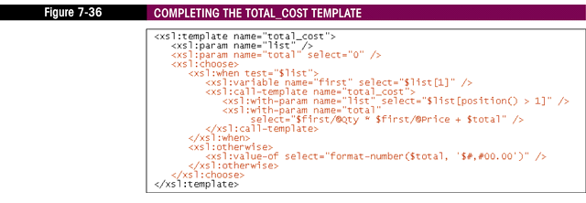
RECURSIVE TEMPLATE

Slide 39
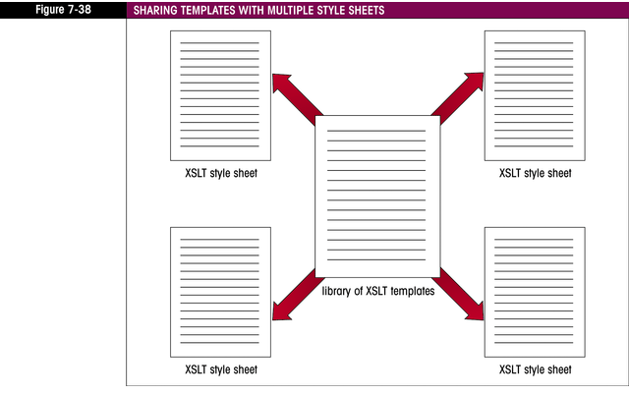
WORKING WITH MULTIPLE STYLE SHEETS

Slide 40
WORKING WITH MULTIPLE STYLE SHEETS
Use to create a library of XSLT code
<xsl:include>
  Syntax: <xsl:include href=”URL” />
  Same as inserting the components of included sheet directly into including file
  Does not perform a direct text copy
  Performs logical copy
  If naming conflict occurs, last occurrence of template is used

Slide 41
WORKING WITH MULTIPLE STYLE SHEETS
<xsl:import>
  Syntax: <xsl:import href=”URL” />
  Must be at the top level of the style sheet; must be first child of <xsl:stylesheet>
  If name conflicts occur, importing sheet takes precedence

Slide 42
WORKING WITH EXTENSION FUNCTIONS
Provide extended functionality specific to XSLT processor
Extension functions - extend the list of functions available to XPath and XSLT expressions
Extension elements - extend the list of elements that can be used in an XSLT style sheet
Extension attributes - extend the list of attributes associated with XSLT elements
Extension attribute values - extend the data types associated with XSLT attributes

Slide 43
WORKING WITH EXTENSION FUNCTIONS
Check processor documentation for support
EXSLT:
  Proposed common set of extensions
  Not fully supported by all processors
  Some functions supported by:
    4XSLT
    saxon
    jd.xslt
    libxslt
    Xalan-J

Slide 44
USING EXTENSIONS
Modify <xsl:stylesheet>:
    <xsl:stylesheet version=”1.0”
    xmlns:xsl=”http://www.w3.org/1999/XSL/Transform”
    xmlns:math=”http://www.exslt.org/math”
    extension-element-prefixes=”math”>
Syntax: prefix:function()
Test function availability: function-available(“extension”)

Slide 45
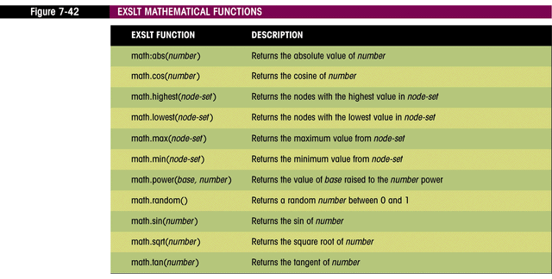
EXSLT MATH FUNCTIONS

Slide 46
WRITING EXTENSION FUNCTIONS (MSXML)
Add:
  <msxsl:script language=”language” implements-prefix=”prefix”>
  script commands
  </msxsl:script>

Slide 47
WORKING WITH EXTENSION ELEMENTS AND ATTRIBUTES
Must be associated with a namespace
Saxon XSLT processor:
  Allows variables to be changed:
    <xsl:variable name=”name” saxon:assignable=”yes” />
    <saxon:assign name=”name” select=”expression” />
  Allows program loops:
    <saxon:while test=”condition”>
    XSLT and literal result elements
    </saxon:while>

Slide 48
WORKING WITH EXTENSION ELEMENTS AND ATTRIBUTES
Testing element availability:
  Element-available(“extension”)
  Use <xsl:fallback> element
    Provides an alternate set of instructions for processors that do not support an element extension

Slide 49
SUMMARY
<xsl:number> and position() are used to number elements
XPath provides mathematical and string operators
Standard mathematical operators (+, -, etc.) can be used in XSLT
Number formatting uses format-number() function
XSLT expressions are placed in HTML attributes using {} operators

Slide 50
SUMMARY
White space characters are controlled with various XSLT elements and XPath functions
Variables and parameters are used to supply user-defined values
XSLT is a functional programming language
Recursive templates provide looping logic in XSLT
EXSLT provides a set of extension functions, elements, attributes and attribute values

